Slide 1
Implementing National Security Education
in the Junior Secondary English Language Curriculum
An Example of Learning and Teaching Activities
Topic: China’s Space Exploration

Slide 2
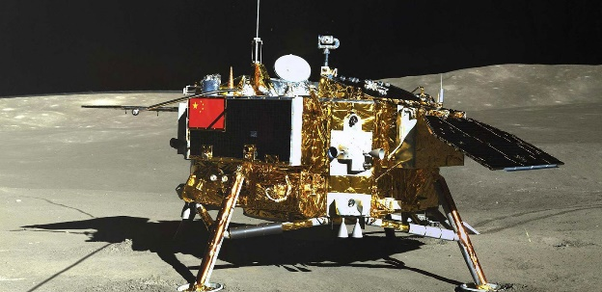


Module | Unit | Topic
Wonderful Things | Successful People and Amazing Deeds | China’s Space Exploration
Content Objectives
To explore concepts related to outer space security, e.g.
space exploration
the development and achievements of China’s lunar exploration programme
the future plans of China’s lunar exploration
Language Objectives
To develop language knowledge and skills, e.g.
English Language
Education
National Security
Education
China’s Space Exploration
listening, speaking, reading/viewing and writing skills
text structures (i.e. a video, an article, a mind map)
the use of the passive voice

Slide 3

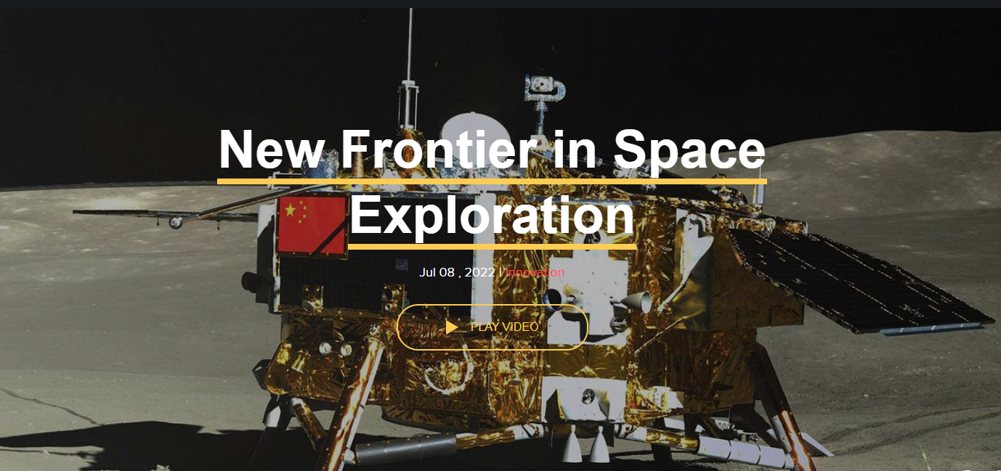
Pre-viewing
Find out how much students know about China’s space exploration.
While-viewing
Play the video.
Post -viewing
Use the article “Chang'e 7 Robotic Mission to Search for Ice and Survey South Pole Landforms” to discuss the missions of Chang’e 7 with students.
Engage students in finding out the different phases and achievements of the Chang’e lunar exploration programme, and its future plans and goals.
Guide students to do some reflections and share their opinions.
A Video on
“New Frontier in Space Exploration”
Source: The China Current:
https://chinacurrent.com/story/23770/new-frontier-in-space-exploration

Slide 4
About China’s Space Exploration:
Sample guided questions
  Find out how much students know about China’s space exploration.
Pre-viewing
Do you know the name of China’s lunar exploration programme?
When did China start the lunar exploration programme?
What are astronauts in China called?

Slide 5
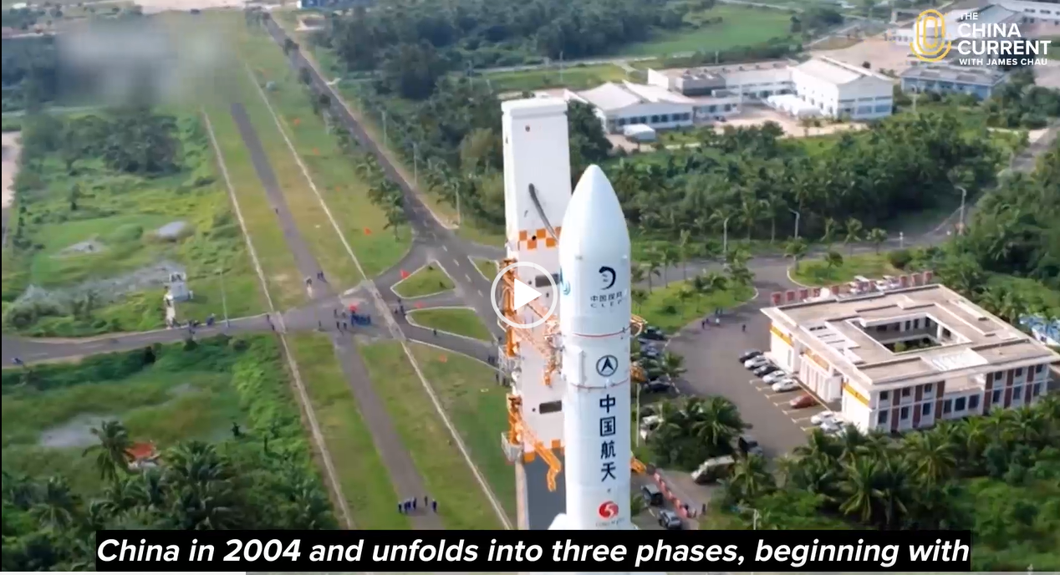
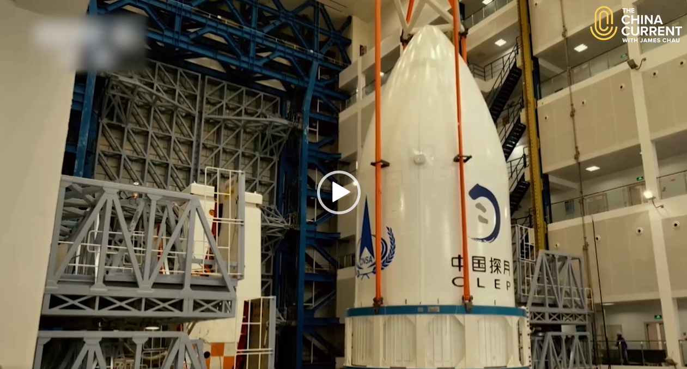
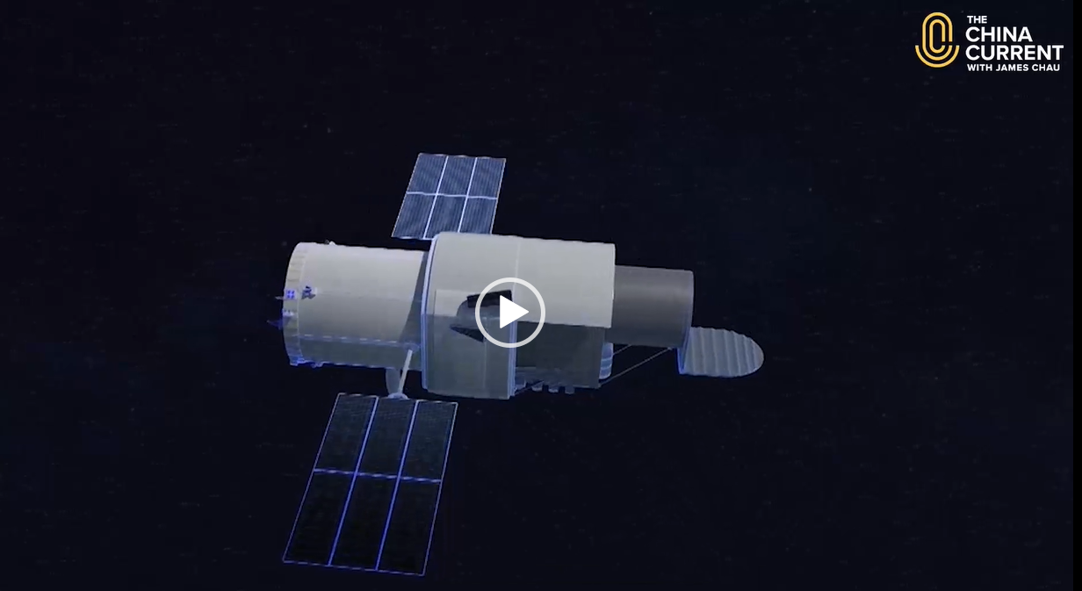
  Play the video.
  Engage students in finding out the different phases and achievements of the Chang’e lunar exploration programme, and its future plans and goals.
A Video on
“New Frontier in Space Exploration”
While-viewing
Video Time: 00:00 – 01:37
Video Time: 01:17 – 01:48
Video Time: 01:48 – 02:24
  What are the different phases and achievements of the Chang’e lunar exploration programme?
  What are the future missions of the Chang’e lunar exploration programme?
  What are the goals and expected outcomes of the Chang’e lunar exploration programme?
Source: The China Current:
https://chinacurrent.com/story/23770/new-frontier-in-space-exploration

Slide 6
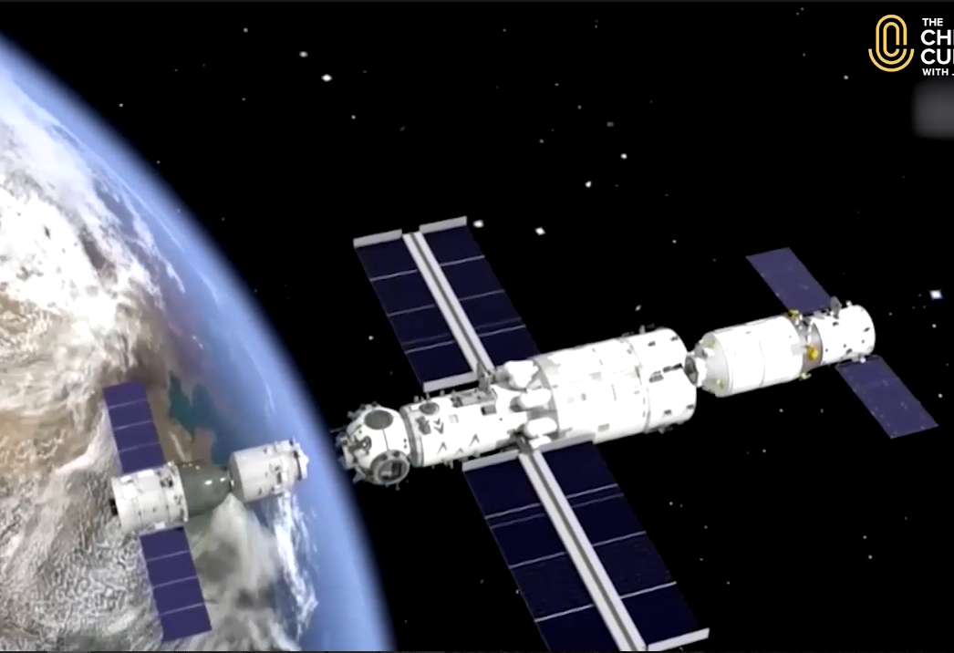
  Use the article “Chang'e 7 Robotic Mission to Search for Ice and Survey South Pole Landforms” to discuss the missions of Chang’e 7 with students.
Post-viewing
An Article on
“Chang'e 7 Robotic Mission to Search for Ice and Survey South Pole Landforms”
Preceding success
Mission
Chang’e 5
Chang’e 7
Achievements
Source: Chang’e 7 Robotic Mission to Search for Ice and Survey South Pole Landforms. (2022, March 11). China National Space Administration.
Destination
Favourable conditions

Slide 7
  Guide students to identify the use of the passive voice in the video and the article.
Post-viewing
An Article on
“Chang'e 7 Robotic Mission to Search for Ice and Survey South Pole Landforms”
A Video on
“New Frontier in Space Exploration”
China’s lunar exploration programme is named for Chang’e.
The Chang’e lunar exploration programme was created by China in 2004.
The fourth phase for Chang’e will be divided into Chang’e 6, 7 and 8 that is scheduled to begin in 2024.
The Chang'e 7 mission is set to find traces of ice at the south pole, investigate the environment and weather there, and survey its landforms.
It will also be tasked with detecting the natural resources beneath the south pole's surface.
He said the selection of the south pole as Chang’e 7’s destination was based on two major considerations.

Slide 8

  Guide students to do some reflections and share their opinions.
Reflection
What are some effective ways to increase people’s understanding and awareness in outer space security?
How can young people in Hong Kong contribute to the national space exploration?
Why is space exploration important and beneficial to our country?
How is outer space security related to other fields of national security (e.g. homeland security, military security, etc.)?
References:
https://www.nsed.gov.hk/national_security/index.php?l=en&a=national_security_main_focus

Slide 9
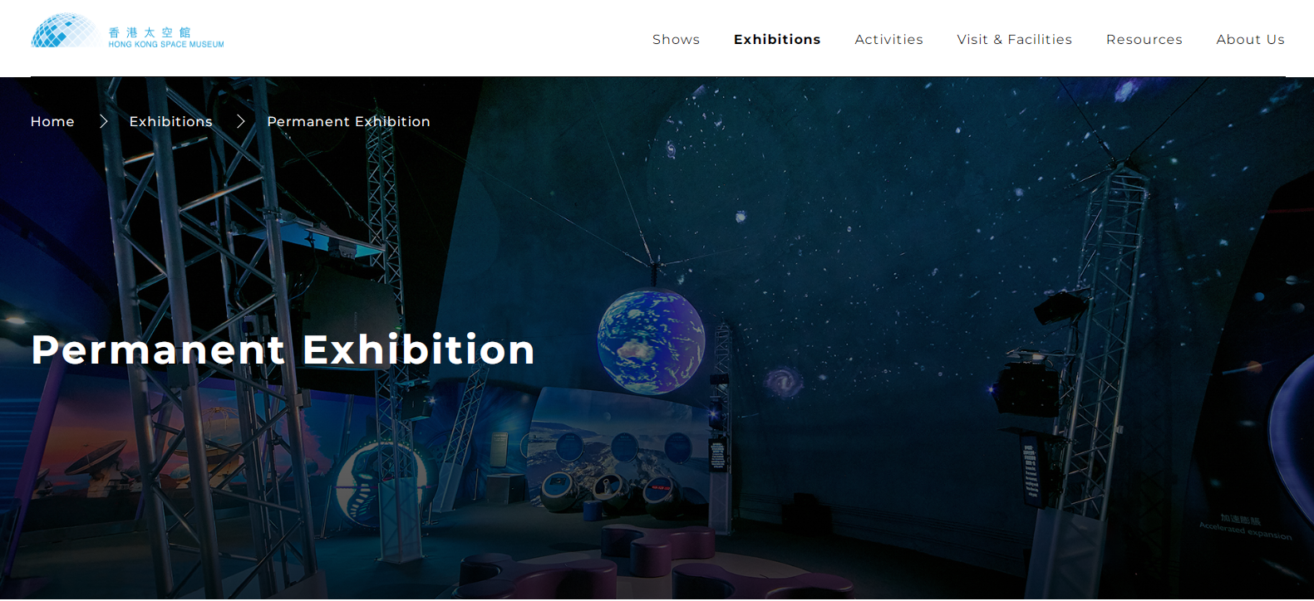
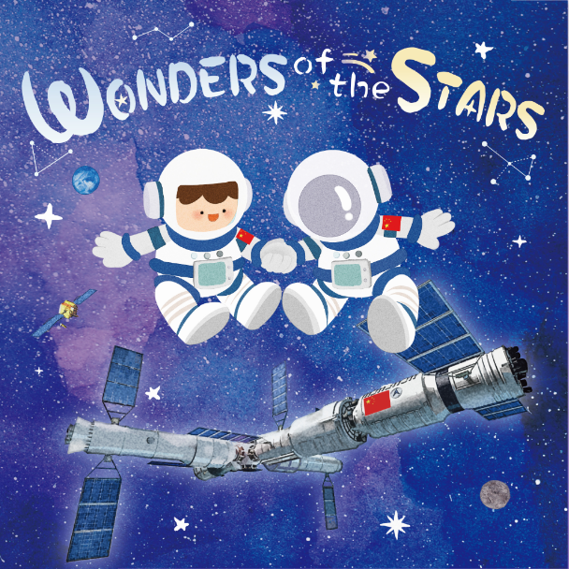
Extended Learning Activities
Guide students to read the picture book “Wonders of the Stars” to know more about the achievements of China’s space exploration and how outer space security is related to our daily lives.
Invite students to give presentations on the following topics:
- the challenges faced by taikonauts
- the achievement of China’s space exploration that impresses him/her most
- the future of China’s space exploration
Arrange a museum tour to the Hong Kong Space Museum to provide opportunities for students to explore more on the development of space exploration and space technology.
https://www.nsed.gov.hk/booklet.php?b=picture_book_en.pdf
Sources:
Hong Kong Space Museum: https://www.lcsd.gov.hk/CE/Museum/Space/en_US/web/spm/exhibitions/permanent-exhibition.html
Wonders of the Stars: https://www.nsed.gov.hk/media/index.php?l=en&a=picture_book

